Slide 1
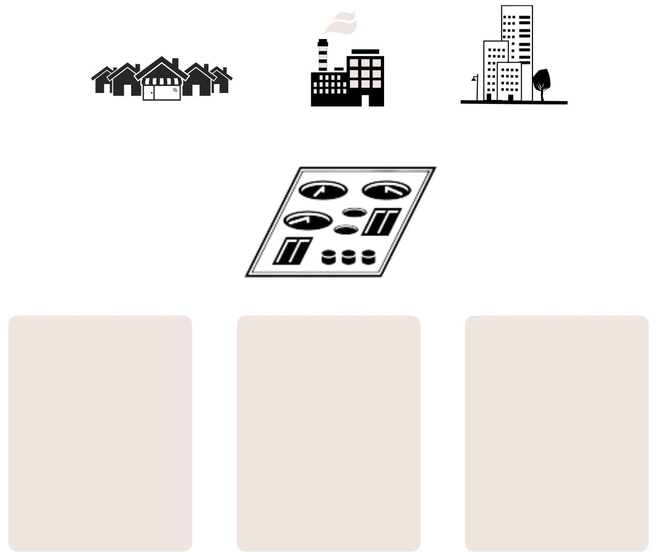
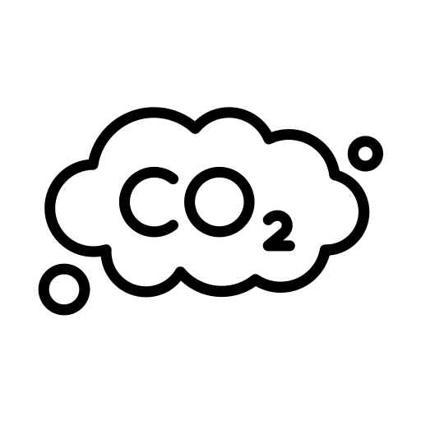
Are we adapting wastewater treatment processes to climate change fast enough?
VAZ, V. P. ^{1,2,3}*; FERREIRA, F. D. G.¹; CARLON, P.¹; NUNES, A.S.¹; DEWEZ, D.², JUNEAU, P.²; MATIAS, W. G.³; MAGRI, M. E.¹
1 Laboratory of Resource Recovery in Sanitation Systems (RReSSa), Department of Sanitary and Environmental Engineering, Federal University of Santa Catarina, Florianópolis, SC, Brazil
2 Institute of Environmental Sciences, Université du Québec à Montreal, Montreal, Québec, Canada.
3 Laboratory of Environmental Toxicology (LABTOX), Department of Sanitary and Environmental Engineering, Federal University of Santa Catarina, Florianópolis, SC, Brazil
*Corresponding author
vitorpereiravaz@gmail.com Vitor Pereira Vaz @VitorPVaz
INTRODUCTION
Sea levels rise and subsequent discharge problems
CONCLUSIONS
Effects of climate change are already being seen as consequences of the increase of at least 1.5ºC on the global average^{[1]}. Quantifying these effects has been a task in fields such as hydrology, climatology, biology, and toxicology, providing an overview of the situation so that regulators can act up to reduce its effects, but also so that society can be prepared for new scenarios. Sanitation as a field of study however has not yet shown great efforts to modify Wastewater Treatment Plants (WWTP) processes to adapt to the induced (and future) changes ^{[2]}. This work aims to discuss the measures being taken globally to minimize the impacts of climate change in wastewater treatment processes while reducing its impact on the climate and discuss perspectives.
Coastal WWTP that discharge directly into the ocean or rivers close to the ocean could become submerged thus demanding pumping of the effluent, raising the energy consumption;
In situ treatments depend on the groundwater level to be efficient and coastal cities tend to have high groundwater levels;
Contaminated groundwater could be the source of contamination for the families nearby.
Actions must be taken to avoid greater environmental impact due to WWTP and their response to a rapidly changing environment;
Adapting to climate change demands efforts from all areas of study;
A greater integration between the operation of WWTP and academia could help boost a positive outcome which would reduce the harmful effects of a greater precipitation or the raise in the sea level.
PERSPECTIVE
REFERENCES
Main effects of Climate change on WWTP
^{[1]}
IPCC. (2021). Climate Change 2021: The Physical Science Basis. Cambridge University Press. Retrieved from https://www.ipcc.ch/report/ar6/wg1/
Increased emission of greenhouse gases (GHG)
^{[2]}
Langeveld, J. G., Schilperoort, R. P. S., & Weijers, S. R. (2013). Climate change and urban wastewater infrastructure: There is more to explore. Journal of Hydrology, 476, 112–119. https://doi.org/https://doi.org/10.1016/j.jhydrol.2012.10.021
During the treatment process, the emission of GHG is associated with microbial degradation of the organic matter;
Increase on the average global temperature will accelerate organic matter degradation and its subsequent GHG emissions;
Case studies show increase in Biological Oxygen Demand (BOD) and Chemical Oxygen Demand (COD) removal during summer and a decrease on the same parameters during winter comparing different temperature increase scenarios ^{[3]}.
Wastewater
Abdulla, F., & Farahat, S. (2020). Impact of Climate Change on the Performance of Wastewater Treatment Plant: Case study Central Irbid WWTP (Jordan). Procedia Manufacturing, 44, 205–212. https://doi.org/https://doi.org/10.1016/j.promfg.2020.02.223
Wastewater Treatment Plants (WWTP)
^{[3]}
Perspective
^{[4]}
Zouboulis, A., & Tolkou, A. (2015). Effect of Climate Change in Wastewater Treatment Plants: Reviewing the Problems and Solutions. In Managing Water Resources Under Climate Uncertainty: Examples from Asia, Europe, Latin America, and Australia (pp. 1–438). https://doi.org/10.1007/978-3-319-10467-6
Increased sewage volume for treatment during hydrological events
The enclosing of WWTP and collection of the gases generated
Operational changes in WWTP
Investing in pumping the effluent
^{[5]}
Major, D., Omojola, A., Dettinger, M., Hanson, R., & Sanchez-Rodriguez, R. (2011). Climate change, water, and wastewater in cities: first assessment report of the urban climate change research network. Cambridge University Press. Cambridge.
Calculations on the capacity of a given WWTP are based on series of hydrological data, meaning changes in precipitation could overflow some WWTP;
Future projections are not in accordance with has happened until the current days.
In situ treatments
Relocating ^{[5]}
Changing the WWTP to a higher ground
Raising funds
Acknowledgements:

