Slide 1
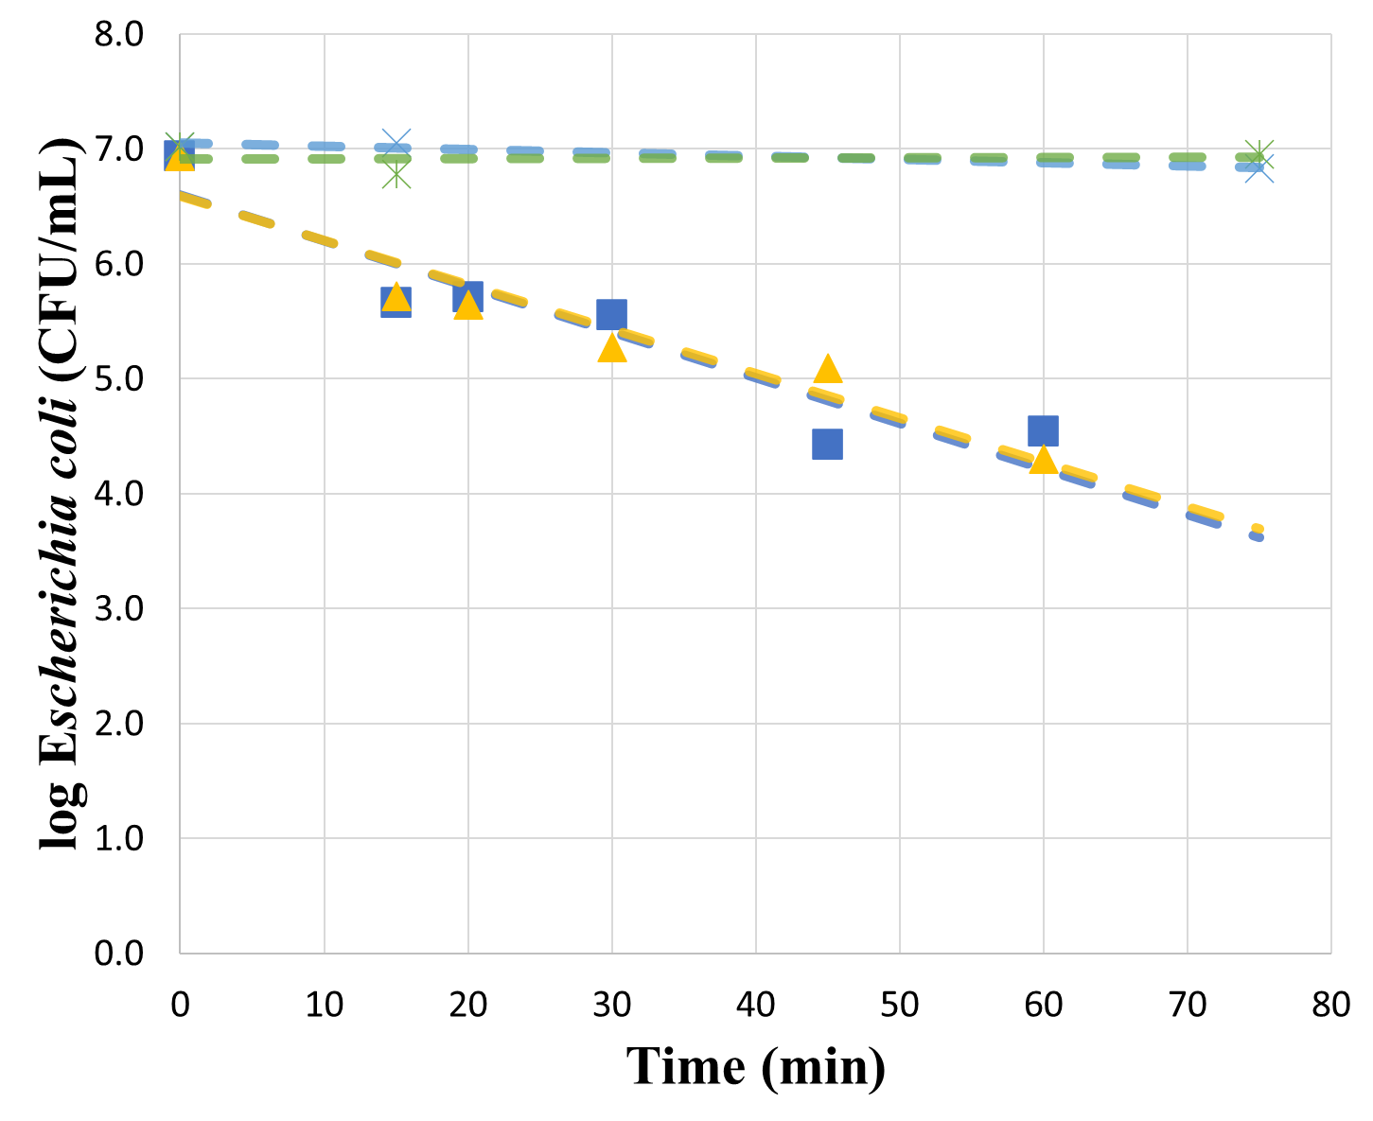
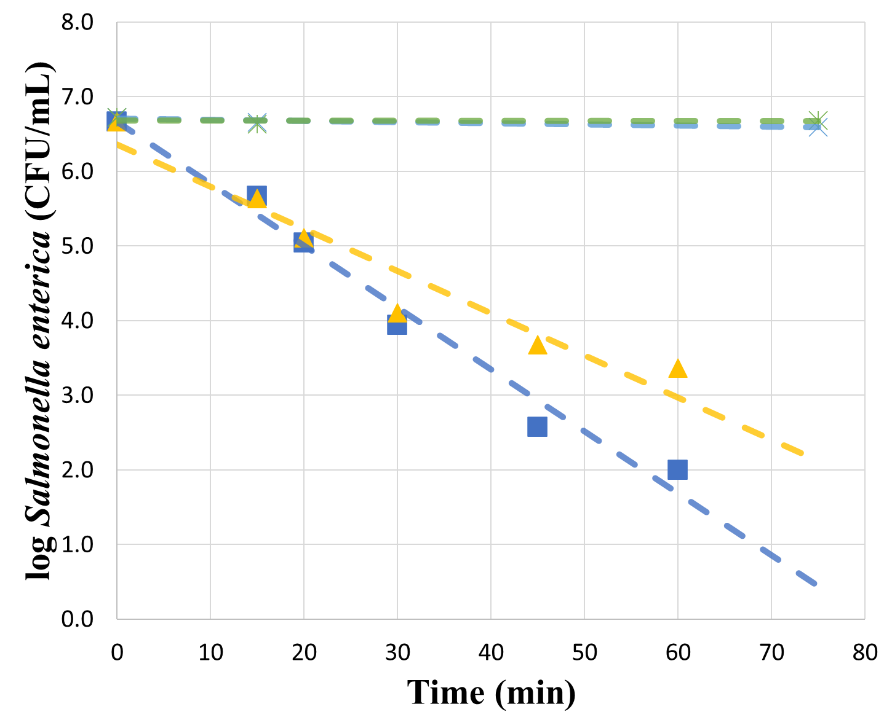
EVALUATION OF BACTERIA AND BACTERIOPHAGES BEHAVIOR DURING STRUVITE PRECIPITATION
FRANCO, L. C.; CARLON, P.*; SCHWARZ, D.L; NUNES, A.S.; FERREIRA, F.D.G; VAZ, V.P.;MAGRI, M.E.
Resource Recovery in Sanitation Systems Research Group (RReSSa), Department of Sanitary and Environmental Engineering, Federal University of Santa Catarina, Florianópolis, SC, Brazil
*Corresponding author: priscila.carlon@gmail.com
INTRODUCTION
RESULTS
CONCLUSIONS
Struvite is a crystal substance made from urine that can be used as a fertilizer^{[1]}. Even though urine comprises little or none of the human pathogens, there is a risk of cross-contamination with pathogens from human feces during collection. The recommended treatment by the World Health Organization is storage. However, studies are showing that storage may not be effective in achieving a complete pathogen inactivation^{[2]}. The aim of this study was to investigate the behavior of the bacteria Escherichia coli and Salmonella enterica and the bacteriophages ΦX-174 and MS2 on the liquid supernatant during struvite precipitation and on struvite during the drying process.
Microorganisms’ inactivation in urine
Microorganisms’ inactivation in struvite
Microorganisms can remain active through long periods in urine. Therefore, it is essential to assure the surplus liquid phase from the struvite precipitation process is securely manipulated and goes through efficient sanitization before being reused or discarded.
The same concern should be taken with the struvite, by means of guaranteeing the security of the final product.
Thus, caution with the final product storage is essential to avoid recontamination or regrowth of pathogen in struvite that will be distributed and applied.
E. coli and S. enterica concentration in urine showed a mean reduction of 2.39 and 4.67 log10 CFU.mL⁻¹ with MgCl₂, respectively.
After 60 min, the concentration of bacteria was below detection limits (Fig. 1).
Control experiments using deionized water with pH 9.0 and electric conductivity 38.0 mS showed no reduction in the concentration of the bacteria. Therefore, the pH and electric conductivity of the urine did not influence the bacteria. Previous studies show that bacteria inactivation in urine is related to its non-ionized ammonia concentration^{[6]}.
Bacteriophages concentration in urine showed no significant variance, exhibiting mean values of 4.09×10⁷ and 3.35×10⁷ PFU.mL⁻¹ for ФX-174 and MS2, respectively. Previous studies show inactivation coefficients in urine at 24ºC that result in a T90 of 15 d for MS2 and 12 d for ФX 174^{[6]}. As the duration of the experiment was 75 min, no reduction was observed.
Bacteria concentration on the precipitate was high for E. coli and S. enterica, which possibly means that the reduction on bacteria concentration on liquid phase was also due to sedimentation and adsorption of bacteria on struvite.
After drying for 24 h at room temperature, there were no concentrations above the detection limits for bacteria.
Bacteriophages showed no sedimentation of phages nor adsorption on struvite. The former occurred by the reduced size of phages, which do not sediment on liquids. The latter occurred by electrostatic repulsion between negative charges of struvite and phages under the pH of stored urine^{[7]}.
Using T90, it was estimated the time to reduce 4log10 on the concentration. The longest time for 4log10 reduction on struvite was 99.0 h, observed for ФX 174 (Table 1).
METHODS
Human urine was collected and stored for 3 weeks.
The microorganisms evaluated, Escherichia coli ATCC13706, Salmonella enterica serovar Typhimurium WG49NCTC12484, MS2 ATCC15597-B1, and ΦX-174 ATCC13706-B1, were inoculated at a 1% concentration of the total wet mass in 500 mL of urine before struvite production.
Samples for S. enterica and E. coli determination were spread on XLD and MacConkey agar, respectively, and cultivated at 37°C for 24 h. The bacteriophage assay used the double agar method^{[3][4][5]}.
The experiment configuration was molar ratio of 3.3 Mg:P using magnesium chloride, pH 9.1, rotation at 130 rpm, stirring time 15 min, and sedimentation time 1 h.
The sampling time for urine was 0, 15, 20, 30, 45, 60, and 75 min for bacteria and 0, 15, 30, 45, 60, and 75 min for bacteriophages. The sampling time for struvite was after 1-h sedimentation and after 24 and 48 h of drying at room temperature (25ºC).
REFERENCES
^{[1]} Rubio-Rincón, F.J., Lopez-Vazquez, C.M., Ronteltap, M., Brdjanovic, D., 2014. Seawater for phosphorus recovery from urine. Desalination 348, 49–56. https://doi.org/10.1016/j.desal.2014.06.005
^{[2]} Bischel, H.N., Özel Duygan, B.D., Strande, L., McArdell, C.S., Udert, K.M., Kohn, T., 2015. Pathogens and pharmaceuticals in source-separated urine in eThekwini, South Africa. Water Res. 85, 57–65. https://doi.org/10.1016/j.watres.2015.08.022
^{[3]} Adams, M., 1959. Bacteriophages, Interscience Publishers. Interscience Publishers, New York.
^{[4]} ISO 10705-1, 1995. Water Quality—detection and enumeration of bacteriophages. Part 1: enumeration of F-specific RNA bacteriophages.
^{[5]} ISO 10705-2, 2000. Water quality - Detection and enumeration of bacteriophages - Part 2: Enumeration of somatic coliphages.
^{[6]} Vinnerås, B., Nordin, A., Niwagaba, C., Nyberg, K., 2008. Inactivation of bacteria and viruses in human urine depending on temperature and dilution rate. Water Res. 42, 4067–4074. https://doi.org/10.1016/j.watres.2008.06.014
^{[7]} Decrey, L., Udert, K.M., Tilley, E., Pecson, B.M., Kohn, T., 2011. Fate of the pathogen indicators phage ΦX174 and Ascaris suum eggs during the production of struvite fertilizer from source-separated urine. Water Res. 45, 4960–4972. https://doi.org/10.1016/J.WATRES.2011.06.042
Table 1. Estimated time in hours for 4log10 reduction of E. coli, S. enterica, ФX-174, and MS2 on urine and struvite, produced with magnesium chloride
Microorganism | 4log10 reduction in (h) |  | T90 in (h)
 | Urine |  | Struvite
E. coli | 0.90 |  | 44.10
S. enterica | 0.69 |  | 46.10
ФX 174 | - |  | 99.00
MS2 | - |  | 55.90
Fig. 1. E. coli and S. enterica concentration in urine during struvite precipitation with magnesium chloride. Control 1 refers to urine inoculated with bacteria without reagent, control 2 to deionized water with pH 9, and control 3 to deionized water with electric conductivity 38.0 mS.
Acknowledgments:

